Slide 1

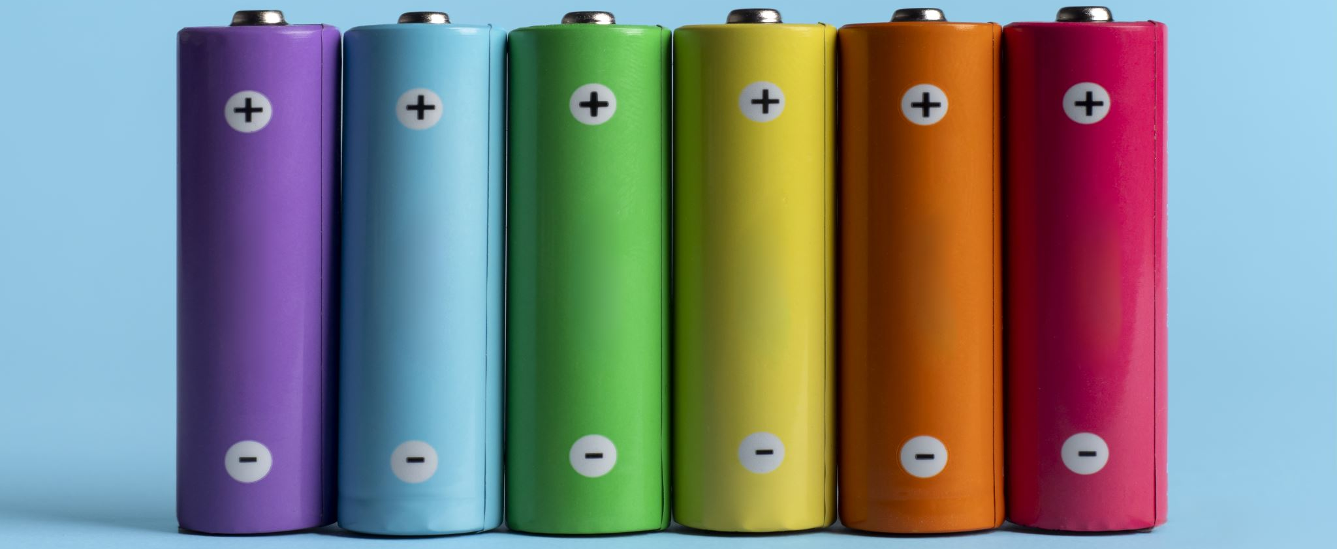
Introduction to Lithium-Ion Batteries
Beausejour Brokenhead Fire Department

Slide 2
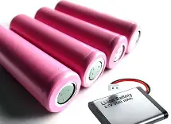
What is a Lithium-Ion Battery?
Lithium-ion batteries (Li-ion) are rechargeable batteries known for their high energy density, lightweight design, and long cycle life, making them essential for modern electronics and electric vehicles.

Slide 3
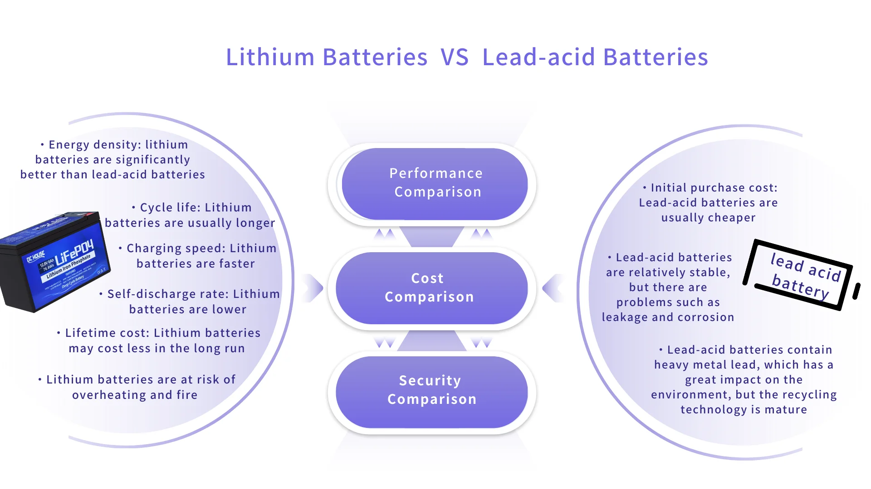
Lithium Ion vs. Lead Acid Battery
The key differences between lead-acid batteries and lithium batteries include their chemistry, energy density, lifespan, weight, cost, and maintenance requirements.
Chemistry- The chemical reactions in lithium batteries are generally more efficient, leading to better performance.
Energy Density- Lithium batteries have a higher energy density compared to lead-acid batteries.
Lifespan- Lithium batteries often have a lifespan of 8-15 years with numerous charge cycles, while lead-acid batteries typically last 3-5 years.
Weight- Lead-acid batteries are significantly heavier than lithium batteries.
Cost- Lead-acid batteries are generally cheaper upfront, however, the longer lifespan and greater efficiency of lithium batteries can lead to cost savings over time.
Maintenance Requirements- Lead-acid batteries require regular maintenance, such as checking fluid levels and equalization charges. Lithium batteries, on the other hand, are largely maintenance-free due to their design.

Slide 4
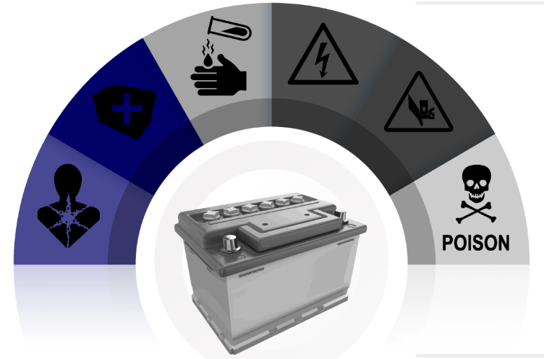
Dangers of Lead Acid Batteries
These risks include:
Acid contact
Fume inhalation
Electric shock
Crushing
Lead exposure
Sulfuric acid - the acid in batteries - is an inherently dangerous substance.
In people, battery acid dangers include:
Burns
Poisoning
Blindness
Internal organ damage

Slide 5
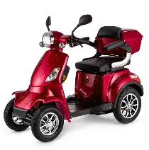
Lithium-ion batteries are found in many electronic devices, such as:
toys
power tools
baby monitors
portable power banks
personal electronics, such as:
  tablets
  laptops
  cell phones
  smartwatches
vaping products (e-cigarettes)
e-mobility products such as e-scooters, e-bikes and mobility aids

Slide 6
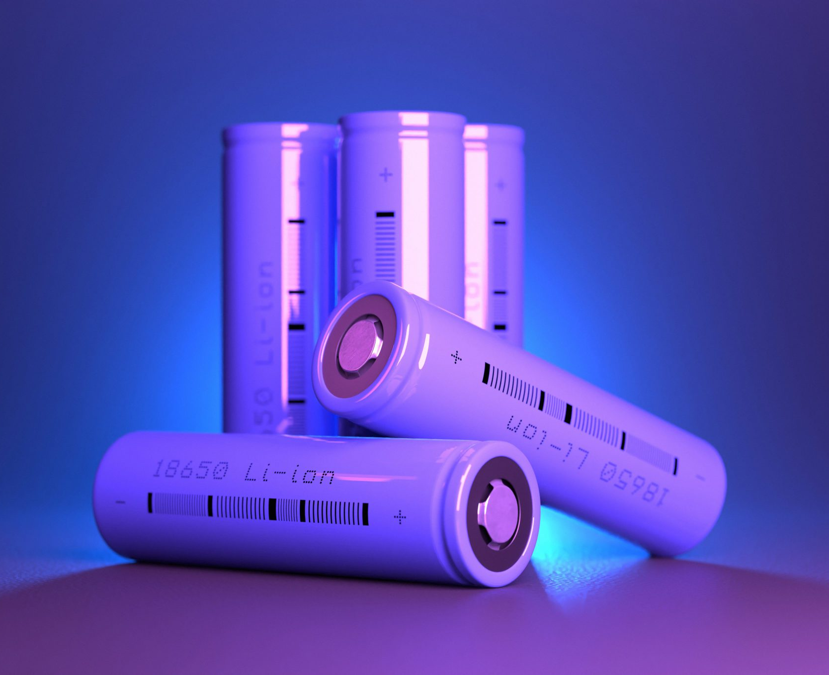
Rechargeable lithium-ion batteries, also called li-ion batteries, are common are generally safe to use. However, they have the same safety risks as other kinds of batteries, including:
overheating
fires
explosions

Slide 7
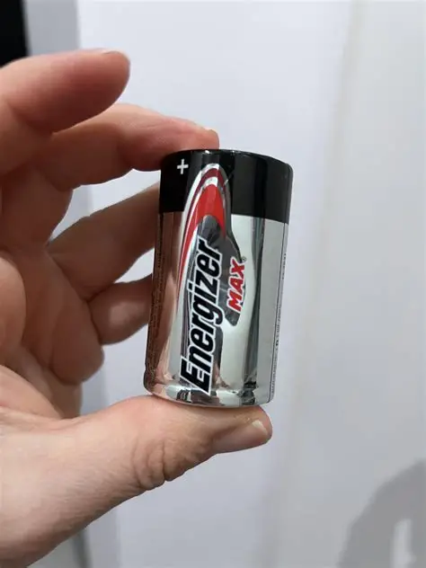
Battery Use
Handle lithium-ion batteries carefully. Do not throw, modify or tamper with them. Check for signs of damage, and don't use batteries that:
are swollen or dented
have torn, plastic wrappers
show other signs of damage or wear

Slide 8
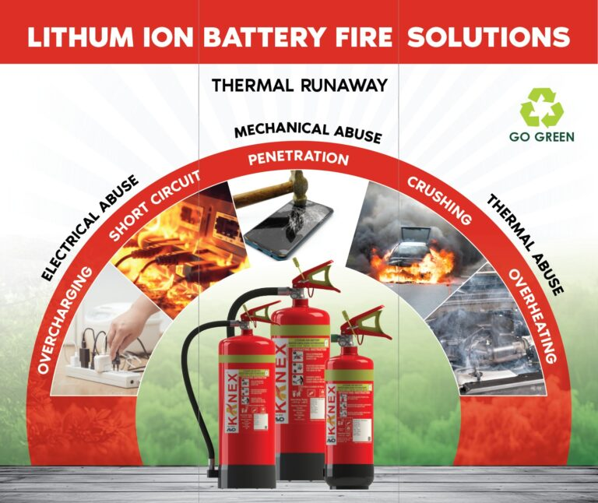
Storage
Store lithium-ion batteries with about a 50% charge when not in use for long periods of time.
Check them every 3 months to make sure they haven't lost their charge.
Store lithium-ion batteries at temperatures between 5 and 20°C.
If your product has removable batteries, you may need to remove them from the product for storage during hotter or colder months.
Store lithium-ion batteries away from:
other types of batteries
flammable or explosive materials
Do not stack heavy objects on top of the boxes containing lithium-ion batteries.
Damaged batteries can cause internal short circuits, which can lead to an explosion.

Slide 9
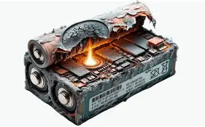
Thermal Runway
A chain reaction that takes place when the cell has reached a certain temperature.
Results in the rapid consumption of the battery cell materials that does not require oxygen.
Accompanied by the venting of hot, flammable gases.
Can quickly spread to other cells, modules, racks, or even containers.
https://youtu.be/24fYrV2vCPk
https://youtu.be/IAAxeXhmQuE

Slide 10
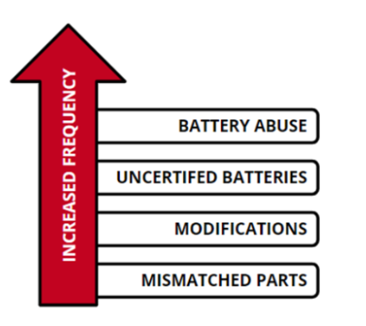
Charging
Do not charge your battery for longer than the recommended charging time. Overcharging can cause your battery to overheat, which can lead to fires or explosions.
Charge your device at room temperature where you can see it. Soft surfaces, like a couch or bed, can trap heat around the battery and cause the device to overheat.
Charge your battery before it drops below 30% to help it last longer and work safely. Do not keep it plugged in and charged at 100% for long periods.
Unlike older types of batteries, you do not need to fully discharge lithium-ion batteries. This may actually harm them.
Charge your product away from exit doors in case of fire.

Slide 11
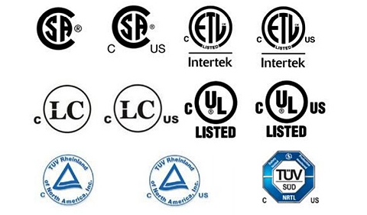
Original and Replacement Chargers
Use the charger that came with your device. If you need to replace your charger, buy it from a trusted source and make sure the voltage and current are compatible with your device.
Contact the original product manufacturer if you need a replacement charger for higher voltage items like e-bikes, remote control cars and power tools.
Only use chargers that have one of the recognized Canadian certification marks.

Slide 12
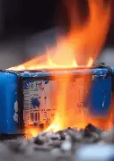
Use
Use the original lithium-ion batteries that came with your product.
Contact the original manufacturer if you need replacement batteries.
If you cannot reach the original manufacturer, contact the product retailer.
Bring batteries to room temperature before using them. Do not attempt to charge in below-zero temperatures.
Do not attempt to modify lithium-ion batteries. Modifying lithium-ion batteries can destabilize them and increase the risk of overheating, fire and explosion.

Slide 13

Disposal
Batteries are considered hazardous waste. Do not place them in household garbage.
Contact your municipality for instructions on how to safely dispose of lithium-ion batteries.
You can visit the official website of the Recycle Your Batteries, Canada! Program to find a drop-off location near you!

